Slide 1
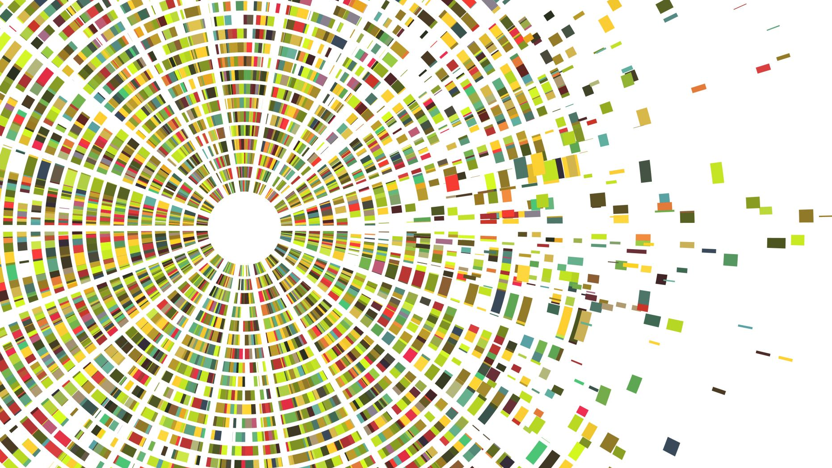
The Urban Tree Canopy of Washington, DC: Distribution of an Urban Resource
AIT 722: Fall 2021. Lensing, Willis

Slide 2
Outline
Introduction / Motivation
Data Acquisition and Preparation
Visualization
Results
Discussion
Conclusion
Website
Notes:
The plan is a refresher re: the problem and some light repetition of mid-term content. Then into new work, visualization, website, etc.

Slide 3
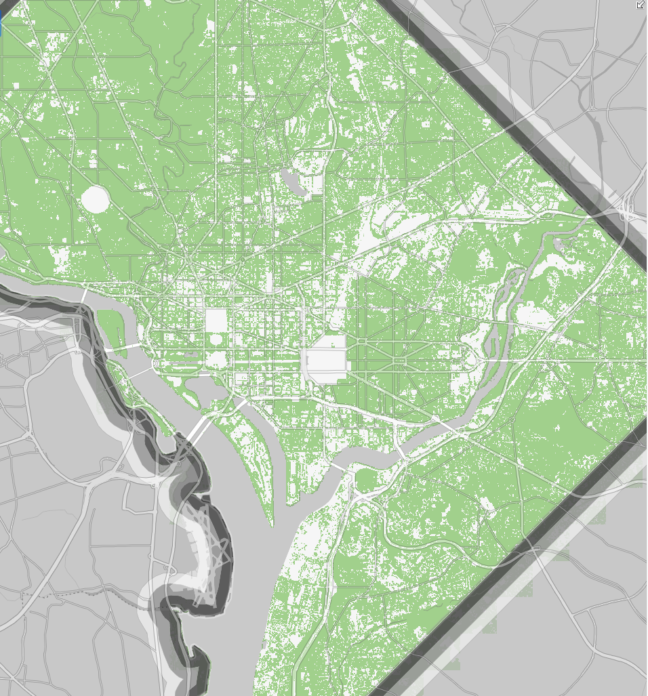
Introduction / Motivation
The Urban Tree Canopy (UTC) provides tangible benefits:
Stormwater Management
Pollution Control
Energy Conservation through Heating and Cooling Moderation
Quality of Life
DC Focus: District target of 40% by 2032.
The non-profit organization American Forests has a specific recommendation for cities like Washington, DC - "forested cities": a target of 40-60% urban tree canopy.
As a public resource, the UTC should be equitably distributed for the common good
Notes:
Establish: (1) relevance (it matters: benefits, citizenry, DC government and non-profit targets) (2) assertion re: a shared resource for the common good

Slide 4
Research Question
Is the Tree Canopy in Washington, DC, equitably distributed?
What are the opportunities and obstacles to equitable distribution?
How can we effectively visualize and share findings?

Slide 5
Challenges
We focused on Washington DC
Data sets were tricky because of the type of data available.
Population data are available at zip code level and census block group level.
53 zip codes in the district, but not all of them are residential
Combining different types of data
Tree canopy data from 2015 offer possible planting areas / opportunity to improve
Other sources were more limited in terms of those opportunities
Combining very granular data (tree data at the street level) with less granular census data at census block or zip code level
Notes:
Acknowledge comments from mid-term prsentation – more relevant, recent data.

Slide 6
Data Set – Tree Canopy
Open Data DC - Urban Tree Canopy by Census Block Group in 2015 (CSV and Geojson formats)
Notes:
https://opendata.dc.gov/datasets/DCGIS::urban-tree-canopy-by-census-block-group-in-2015/about

Slide 7
Data Set – Census
Census Data (2015 - 2019 ACS 5-Year Data Profile)
B17010 - Poverty Status in the Past 12 Months of Families by Family Type by Presence of Related Children Under 18 Years by Age of Related Children (2019)
B19013 - Median Household Income in the Past 12 Months (in 2019 Inflation-adjusted Dollars)
Decennial Census – P1 Race (2020)

Slide 8
Initial visualization

Slide 9
Data and processing
Building acreage held constant to measure the effect of median income on tree canopy
Building acreage and median income as independent variables in the regression

Slide 10
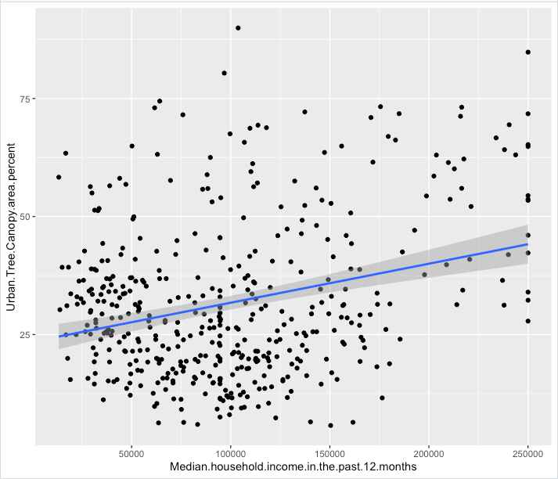
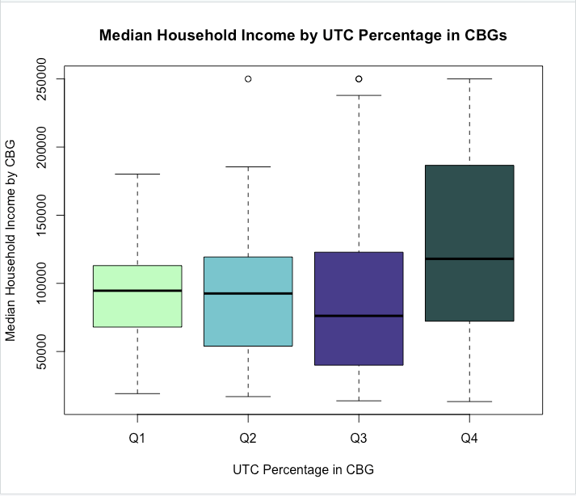
Visualization

Slide 11
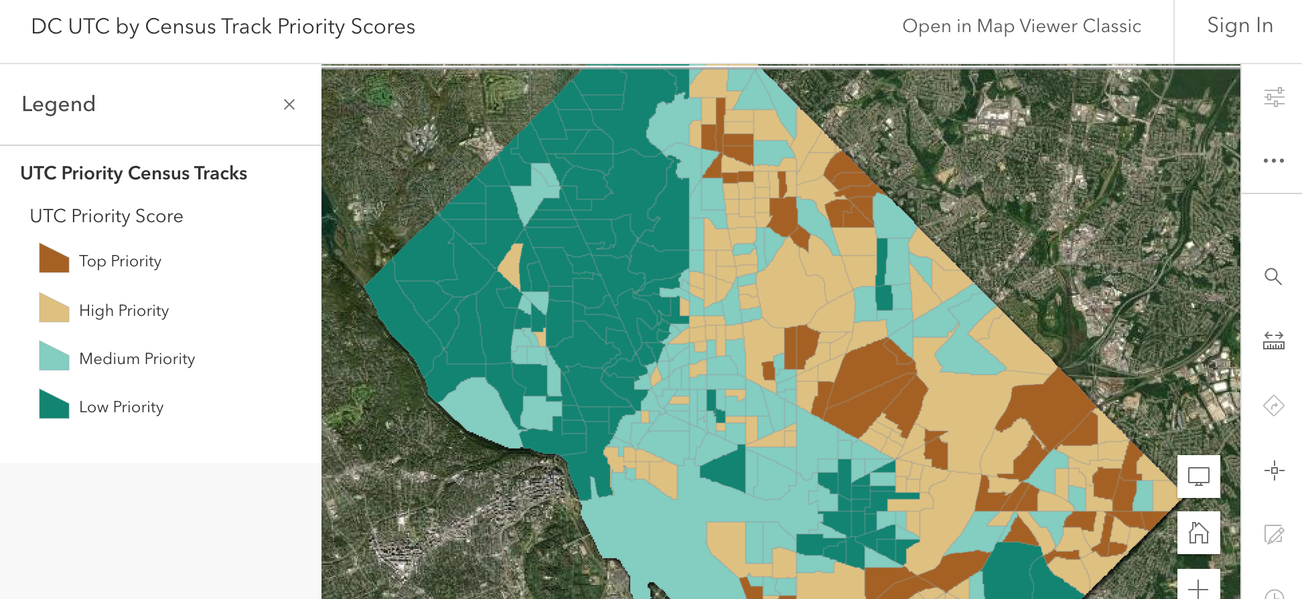

Slide 12
Analysis

Slide 13
Parameters
Notes:
Possibly remove this one

Slide 14
Results
The urban tree canopy is significantly correlated to median income.
The higher income, the higher the percentage of tree canopy

Slide 15
Evaluation and Discussion
We created a "Priority Score" to prioritize planting, incorporating:
Percent of UTC in a CBG
Income level
Total available planting area
Available planting area currently as vegetation (easier than converting impervious areas into UTC)
The "Priority Score" highlights to community planners those areas with: lower income, lower UTC, high available areas for planting, and high vegetation areas so the implementation of the UTC can happen sooner.

Slide 16
Priority score Calculation
Priority Score
Tree Canopy
(Weighted Quartile)
Income
(Weighted Quartile)
Total %
Plantable Area
Total %
Plantable Vegetation Area
The Priority Score represents the urgency / priority for investing in expanding the tree canopy for a particular CBG. It is the weighted sum of four parameters: the tree canopy quartile, the income quartile, the percent of available plantable acreage, and the percent of available plantable acreage covered by vegetation (i.e., not asphalt).
The two quartile parameters – Tree Canopy and Median Household Income – are assigned a value based on the quartile: 1st Quartile (0.4), 2nd Quartile (0.3), 3rd Quartile (0.2), 4th Quartile (0.1). The highest possible total raw score is 2.8, which we normalize (dividing by 2.8) to a value from 0 to 1.

Slide 17
Priority Locations
Census Block Group | Priority Score | Median Household Income | Tree Canopy Quartile | Poverty Per Capita | Total White Residents | Total Black Residents | Income Quartile | Total Plantable Area Percentage | Plantable Vegetation Percentage
110010076015 | 0.577 | $27,976 | Bottom | 2.99% | 51 | 733 | Bottom | 45.5% | 37.7%
110010088042 | 0.558 | $31,652 | Bottom | 3.52% | 241 | 963 | Bottom | 41.9% | 34.4%
110010099031 | 0.519 | $60,875 | Bottom | 2.87% | 16 | 958 | Second-Bottom | 49.3% | 25.9%
110010074042 | 0.517 | $90,694 | Second-Bottom | 0.8% | 25 | 994 | Second-Bottom | 48.2% | 36.5%
110010089041 | 0.514 | $38,208 | Bottom | 14.8% | 144 | 608 | Bottom | 39.8% | 26.4%
110010095083 | 0.509 | $37,045 | Second-Bottom | 2.88% | 102 | 242 | Bottom | 42.3% | 30.3%
110010076051 | 0.508 | $52,279 | Bottom | 3.35% | 31 | 653 | Second-Bottom | 44.0% | 28.1%
110010033011 | 0.507 | $126,292 | Bottom | 0% | 570 | 490 | Top | 53.6% | 38.4%
110010073011 | 0.500 | $94,677 | Bottom | 2.43% | 640 | 116 | Second-Top | 44.3% | 36.6%
110010098021 | 0.490 | $17,727 | Bottom | 12.3% | 1 | 885 | Bottom | 44.3% | 14.6%

Slide 18
Conclusion
The current Urban Tree Canopy is inequitably distributed.
Thus, future planning and efforts should focus on investing to address both the macro goal (40% by 2032) and ensuring an equitable outcome for the city.
Using a measure such as the "Priority Score" proposed in this research offers an actionable measure of both current inequity and where to target resources for an equitable city-wide outcome.

Slide 19
Limitations and Future Work
Limitations of our work include:
Limitations in the data available and the mismatches we dealt with between census data and tree canopy data
Limited focus to Washington, D.C.
The canopy was treated as if it were a binary entity, but the quality and maturity of trees affects their value / impact
Future work might consider the following:
Consider other factors beyond those in this initial work
Incorporate feedback and further test the priority score system against other results and apply learning to tuning it
Look at other cities and perform comparative work between cities

Slide 20
Website
Audience: City Planners
(1) highlight citizen appreciation of "good things" (2) GIS familiarity (3) focus on the results and make shape files available
Hosted at https://treecanopy.github.io
Our website incorporates the following key elements:
Background on the problem
Explanation of approach
Visualization of key findings
Geospatial visualization
Interactive visualization
Links to additional local and national news about the canopy
Notes:
Visualization may be more or less clever depending on our ability to incorporate

Slide 21
Website Organization is Driven by Questions
Each top-level page addresses a stated or implicit question:
What is the website about? What S&CC problem is explored? (Landing Page / "Project Background")
Contributions from social media highlighting appreciation for the existing canopy ("Appreciation")
Explanation of the analysis and priority scoring for target areas ("Priority Score")
Interactive Visualization and shapefiles ("Urban Tree Canopy")
So what? Why should I care? Why is it important? ("Benefits")
Journalism – local and national news – underscoring interest in the problem ("Learn More")

Slide 22
Technology
Python
Pandas
Numpy
GeoPandas
GeoPlot
Jupyter Notebook
Jekyll, site: imagecolorpicker.com, Pixelmator
Git
R, ArcGIS for Map-based Visualization
Data
DC Open Data – CSV, Shape Files, GeoJSON
Census – CSV, API
Notes:
Are python + bokeh an option for an interactive map? https://towardsdatascience.com/how-to-create-an-interactive-geographic-map-using-python-and-bokeh-12981ca0b567

Slide 23
References
Conniff, R. (2018, May 7) U.S. Cities Lose Tree Cover Just When They Need It Most. Scientific American. https://www.scientificamerican.com/article/u-s-cities-lose-tree-cover-just-when-they-need-it-most/
District of Columbia Department of Energy and Environment. (2021, September 12 retrieval) https://doee.dc.gov/trees
Dwyer, M.C. and Miller, R.W. (2009) Using GIS to Assess Urban Tree Canopy Benefits and Surrounding Greesnspace Distributions. Journal of Arboriculture. (25:2), 102-107. http://www.actrees.org/files/Research/Using%20GIS%20to%20Assess%20Urban%20Trees.pdf
Harden, John D. (2020) D.C. planted nearly 80 trees a day to reach a canopy target. It's running out of space. Washington Post (27 March 2020). https://www.washingtonpost.com/dc-md-va/2020/03/27/tough-place-tree-live-dc-planted-nearly-80-trees-day-reach-canopy-target-its-running-out-space/
Ko, Y. (2018, August) Trees and Vegetation for residential energy conservation: A critical review of evidence-based urban greening in North America. Urban Forestry & Urban Greening. (34: August 2018, 318-335). https://doi.org/10.1016/j.ufug.2018.07.021
Leahy, I. (2017) Why We No Longer Recommend a 40 Percent Urban Tree Canopy Goal. https://www.americanforests.org/blog/no-longer-recommend-40-percent-urban-tree-canopy-goal/
Leff, M. (2016, September 27) The Sustainable Urban Forest: A Step-by-Step Approach. Davey Institute / USDA Forest Service / USFS Philadelphia Field Station. https://www.itreetools.org/documents/175/Sustainable_Urban_Forest_Guide_14Nov2016.pdf
United Nations’ Food and Agriculture Organization. (2016) Benefits of Urban Trees (infographic). http://www.fao.org/3/c0024e/c0024e.pdf

Slide 24

Thank you!

Slide 25

recycling
bin

Slide 26
Data and Acquisition
DC Government's Open Data
Individual tree-level granularity
US Census Data
Zip Code
Block-Level
Suitable and unsuitable land for planting
Notes:
IV. Does the proposal provide reasonable technological or data scientific solutions to address the proposed problem? (20%)
Yes. The approach utilizes appropriate and reputable data sources and a methodology appropriate to the problem domain.

Slide 27
Outline
Introduction / Motivation
01
Data Acquisition and Preparation
02
Visualization
03
Results
04
Discussion
05
Conclusion
06
Website
07

Slide 28
Introduction / Motivation
The Urban Tree Canopy provide tangible benefits:
Stormwater Management
Pollution Control
Energy Conservation through Heating and Cooling Moderation
Quality of Life
DC Focus: District target of 40% by 2032.
The non-profit organization American Forests has a specific recommendation for cities like Washington, DC - "forested cities": a target of 40-60% urban tree canopy.
As a public resource, the UTC should be equitably distributed for the common good

Slide 29
Priority score Calculation
PICK ONE SLIDE – this one or the one with boxes
Priority Score
Tree Canopy
(Weighted Quartile)
Income
(Weighted Quartile)
Total %
Plantable Area
Total %
Plantable Vegetation Area
The Priority Score represents the urgency / priority for investing in expanding the tree canopy for a particular CBG. It is the weighted sum of four parameters: the tree canopy quartile, the income quartile, the percent of available plantable acreage, and the percent of available plantable acreage covered by vegetation (i.e., not asphalt).
The two quartile parameters – Tree Canopy and Median Household Income – are assigned a value based on the quartile: 1st Quartile (0.4), 2nd Quartile (0.3), 3rd Quartile (0.2), 4th Quartile (0.1). The highest possible total raw score is 2.8, which we normalize (dividing by 2.8) to a value from 0 to 1.
Notes:
First slide looks nicer to me; second is a little more readable. Do you want to pick one to throw out?

Slide 30
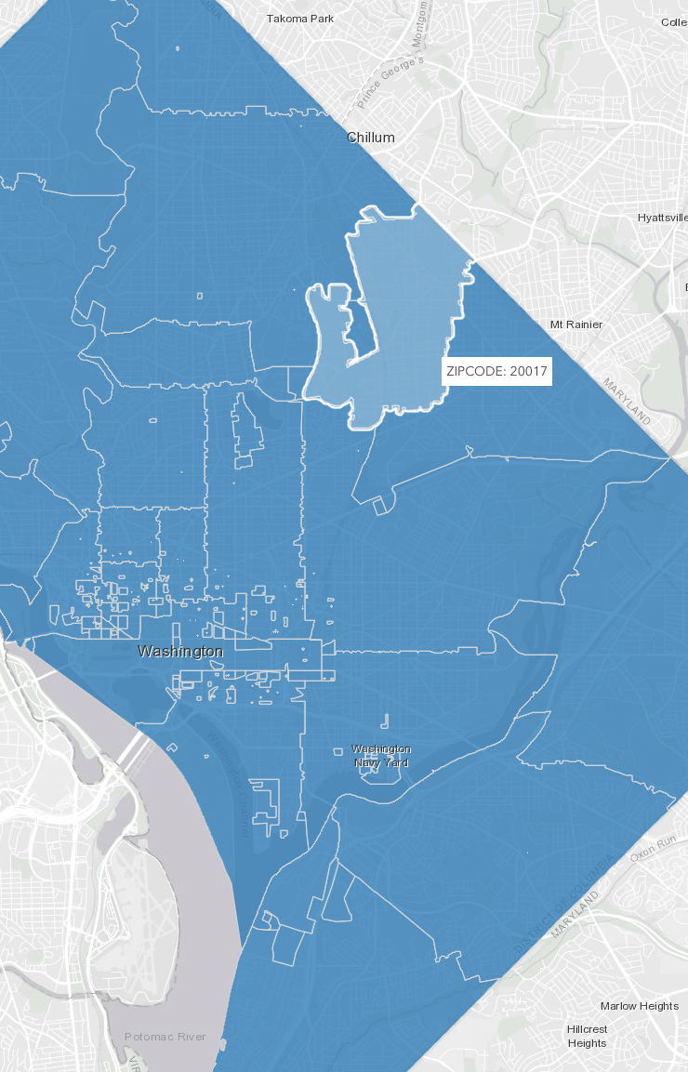
Important Website Elements
Geospatial
Our data are primarily geospatial, so we expect our site will need to provide appropriate visualization of our data and results.
Problem Statement and Background
The Urban Tree Canopy and the connection to S&CC problems needs to be made. We cannot expect a visitor to have prior knowledge. Further, the connection and importance of the question of equitable access must be motivated.
Not Static
Although an interactive capability is not required, we will explore options for incorporating interactivity directly into aspects of visualizing the data. Minimally, we will offer static content in sufficient detail to address our S&CC problem.
Why will our site be better than typical blogs or websites?
We expect it will be because of combination of relevant high-quality content thoughtfully presented with appropriate visualization to explain the problem, our approach, and the results.

Slide 31
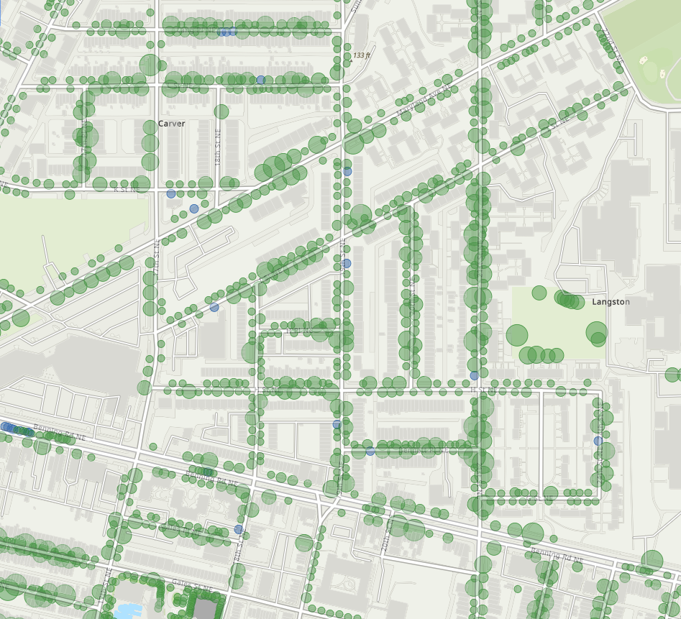
Measuring the Canopy
Measuring the canopy is done at both macro and street-level.
Location, size, and future plantings are tracked.
Aerial views provide a large-scale view of the canopy.
The District's Urban Forestry Division (UFD) tracks trees at as granular a level as the individual tree.
However...
Source: https://dcgis.maps.arcgis.com/home/webmap/viewer.html?webmap=fea6079cf9bc4310a8b6c94f8c2bf1da
Notes:
Map from

Slide 32
Further Reading / Background
Berland, A., et.al. (2017) The role of trees in urban stormwater management. Landscape and Urban Planning (162), 167-177. http://dx.doi.org/10.1016/j.landurbplan.2017.02.017
Tallis, M., et.al. (2011, 30 November) Estimating the removal of atmospheric particulate pollution by the urban tree canopy of London, under current and future environments. Landscape and Urban Planning. (103, Issue 2) 129-138. https://doi.org/10.1016/j.landurbplan.2011.07.003
Nowak, D.J., et. al. (2007) Oxygen Production by Urban Trees in the United States. Arboriculture & Urban Forestry 2007. 33(3):220–226. https://www.nrs.fs.fed.us/pubs/jrnl/2007/nrs_2007_nowak_001.pdf
Ko, Y. (2018, August) Trees and Vegetation for residential energy conservation: A critical review of evidence-based urban greening in North America. Urban Forestry & Urban Greening. (34: August 2018, 318-335). https://doi.org/10.1016/j.ufug.2018.07.021
Leff, M. (2016, September 27) The Sustainable Urban Forest: A Step-by-Step Approach. Davey Institute / USDA Forest Service / USFS Philadelphia Field Station. https://www.itreetools.org/documents/175/Sustainable_Urban_Forest_Guide_14Nov2016.pdf

Slide 33
FURTHER READING / BACKGROUND (2)
Montgomery County Planning (2017, August 18). Tree Canopy Analysis. https://montgomeryplanning.org/planning/environment/forest-conservation-and-trees/tree-canopy-analysis/
O’Neil-Dunne, J. (2011, March 14) A Report on the Montgomery County’s Existing and Possible Tree Canopy. https://www.montgomeryplanning.org/environment/documents/TreeCanopy_Report_MontgomeryCountyFinal.pdf
City of Alexandria Virginia (2019, September 27). Help Grow Alexandria’s Tree Canopy. https://www.alexandriava.gov/recreation/info/default.aspx?id=111539
City of Arlington. (2004) Urban Forest Master Plan. https://arlingtonva.s3.dualstack.us-east-1.amazonaws.com/wp-content/uploads/sites/31/2014/04/Urban-Forest-Master-Plan.pdf

Slide 34
FURTHER READING / BACKGROUND (3)
Maryland Department of Natural Resources (retrieved 2021, September 11). Chesapeake Bay Urban Tree Canopy Goals. https://dnr.maryland.gov/forests/Pages/programs/urban/treecanopygoals.aspx
Teale, C. (2020, October 5) Boston issues RFP for first urban forest plan. Smart Cities Dive. https://www.smartcitiesdive.com/news/boston-design-urban-forest-sustainable-city-plan/586345/
Boston Parks and Recreation (2021, May 21) City of Boston Seeks Partner to Design First Urban Forest Plan. https://www.boston.gov/news/city-boston-seeks-partner-design-first-urban-forest-plan
Alsobrooks, A. Guidelines for Urban Tree Canopy. (retrieved 2021, September 10) Prince George’s County Department of the Environment. https://www.princegeorgescountymd.gov/DocumentCenter/View/32203/Guidelines_Urban-Tree-Canopy

